Slide 1
Dealing With Feelings

Slide 2
Name some feeling words…
POSITIVE | NEGATIVE

Slide 3
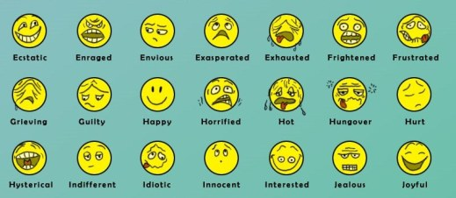
How do I cope with my feelings??
TO COPE MEANS …
To handle your feelings successfully and appropriately.

Slide 4
COPING STRATEGIES
POSITIVE COPING STRATEGY-
Something that helps you feel better about yourself. It solves your problem and is respectful of you and others around you.
NEGATIVE COPING STRATEGY-
It does not help you to feel better. It could cause harm to yourself or others. It doesn’t solve the problem and might make an even bigger one!

Slide 5
Jigsaw activity
Group 1: Column 1
Group 2: Column 2
Group 3: Column 3
5 minutes to go through the strategies and identify the positive or negative coping strategies for your column as a group.
Put a red “X” next to negative coping strategies and a blue star next to positive coping strategies
Materials:
Worksheet
Blue crayon
Red crayon

Slide 6
Discussion Questions
Which strategies do you think are most effective?
What positive coping strategies have you tried when you experience strong emotions?
What happens when you use some of the negative strategies?
Why is important to know how to appropriately deal with our feelings?
What does this have to do with bucket filling?

Slide 7
PRACTICE POSITIVE COPING SKILLS…

