Slide 1
Character Counts Video Clips
Fairness
Respect
Responsibility
Trustworthiness
Caring
Citizenship
Video clips from Values.com

Slide 2
Values.com: LOCKER
http://www.values.com/inspirational-stories-tv-spots/72-Locker

Slide 3
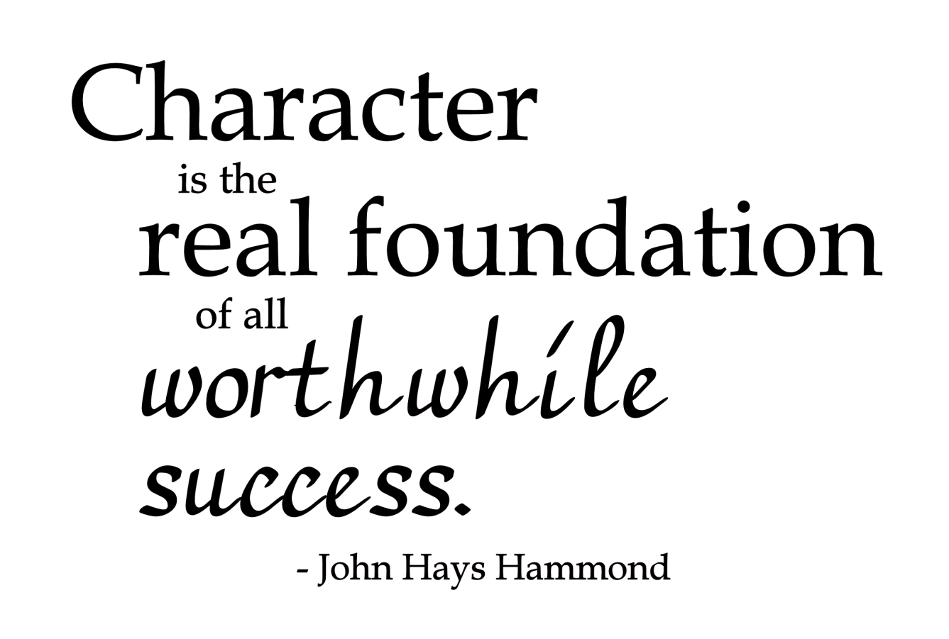
Values.com: Just Say Hi
http://www.values.com/inspirational-stories-tv-spots/111-Just-Say-Hi

Slide 4
Values.com: Timeout
http://www.values.com/inspirational-stories-tv-spots/121-Timeout

Slide 5
Values.com: Peer Pressure
http://www.values.com/inspirational-stories-tv-spots/115-Peer-Pressure

Slide 6
Values.com: Pinata
http://www.values.com/inspirational-stories-tv-spots/102-Pi-ata

Slide 7
Values.com: Generosity
http://www.values.com/inspirational-stories-tv-spots/92-Generosity

Slide 8
Values.com: Reach
http://www.values.com/inspirational-stories-tv-spots/78-Reach

Slide 9
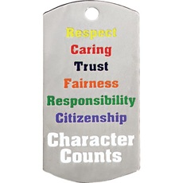
Values.com: Crosswalk
http://www.values.com/inspirational-stories-tv-spots/95-Crosswalk

