Slide 1
Infusing Character Counts Into Your Classroom

Slide 2
Presentation Objectives:
Review the 6 pillars of Character
Identify what strategies you already use to infuse Character Counts into your classroom environment
Name three new ways you can weave Character Counts pillars/concepts into your classroom environment or academic content next year.

Slide 3
Appointment Clock (CC pg. 19)
Time: 2 minutes
Make an appointment with someone in the room for each appointment time (12, 3, 6, & 9)
Write their name in the line provided.
CC activity meant to promote socialization and a great movement break!

Slide 4
Review: 6 Pillars

Slide 5
3 O’Clock Appointment
With your partner, discuss which pillars of character you touch upon often in classroom lessons/discussions (2 minutes)
Volunteers to share?
With your partner, talk about which pillars of character you feel you haven’t talked about as much as a part of social norming or classroom curriculum. (2 minutes)
Volunteers to share?

Slide 6
Infusing Character In Two Ways…
Direct Instruction
This means taking class time to specifically address the character trait as it relates to academic content being discussed, or it could mean teaching a stand alone lesson about a character trait.
Environmental Strategies
Anything we do to promote Character that students observe as part of the classroom environment, daily routine, teaching approach/style.

Slide 7
6 O’Clock Appointment
Time: 5 minutes
Talk with your partner about any strategies you currently use in your classroom (whether it be direct instruction or environmental strategies).
Use the graphic organizer provided to help record your ideas.
Share your ideas with the group (5 minutes)

Slide 8
Integrating Character Education (pg. 76)
Part 1: As an individual
Check off at least 5 of these ideas that you already do.
Circle at least 5 of these ideas that you would consider trying.
Star two ideas that if successfully implemented would make a measureable difference in your classroom.

Slide 9
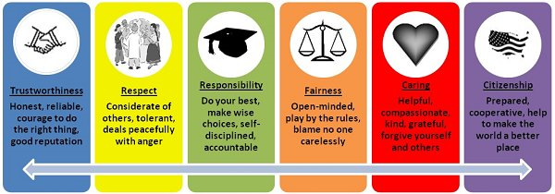
9 O’Clock Appointment
Part 2: With your partner…
Discuss three new strategies that you feel you will attempt to implement in the next school year in your classroom.

Slide 10
Group Share
Share with the group one way you plan to infuse Character Counts into your classroom/curriculum next year.
What conclusions can we draw from this activity?

Slide 11
Video Clip
https://www.youtube.com/watch?v=zfZhReSOP9w

Slide 12
Resources & Hand Outs
Charactercounts.org
Character Counts Games and Activities Manual by Gary Smit (available on the Elementary Guidance website)
Character Counts handout with video links
www.forcharacter.com

Slide 13
References
Smit, G. (n.d.). Games and Activities to Teach Character: Making A Difference By Moving Character From Words to Actions.
Josephson Institute. (2012). Character Counts Training Workbook. Los Angleles, CA: Josephson Institute.

Slide 14
Animals Alive (CC pg. 38)
Am I Ever Lucky? | Hopeful but Clueless | Learning to Make a Difference
Positive results Low understanding of antecedents Unclear as to what practices are initiated to teach character Replication of success is unlikely | Negative results Poor school climate Limited knowledge of character traits and values Low understanding of antecedents | Positive results High understanding of antecedents Frequent and intentional practices Teachers find character connections by finding the intersection between academic content and values Replication of success likely Student and staff engagement
Three types of classrooms:

Slide 15
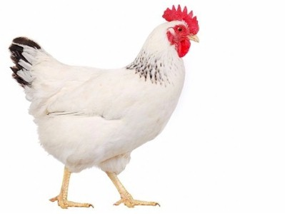
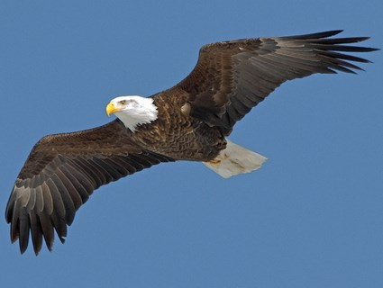
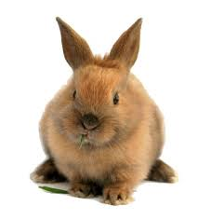
Animals Alive (cont).

Slide 16
12 O’Clock Appointment
What is the point of that activity? Take 2 minutes and discuss with your 6 o’clock appointment.

