Slide 1
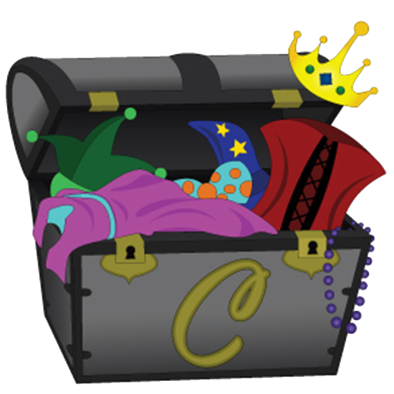
Dressed In My Best Character!!

Slide 2
I am someone who…
MAKES GOOD CHOICES!!!!
Keeps trying- never give up!
Always does my best
Does my jobs at home and at school
Follows rules and directions
Sets a good example for others- I do the right thing (even when no one is watching).

Slide 3
I am someone who…
Follows the Golden Rule
Knows that it is okay if we are all different! (Tolerance)
Uses good manners
Doesn’t hurt anyone on the inside
Doesn’t hurt anyone on the outside
Does what grown-ups ask me to do

Slide 4
I am someone who…
Is nice to everyone (fills a bucket)
Makes others feel good by my words and actions.
Shows others I love them.
Says “thank you” and appreciates the nice things others do for me.
Helps others

Slide 5
I am someone who…
Plays by the rules
Takes turns
Shares
Listens to others (even if I disagree with them)
Treats all people the same.

Slide 6
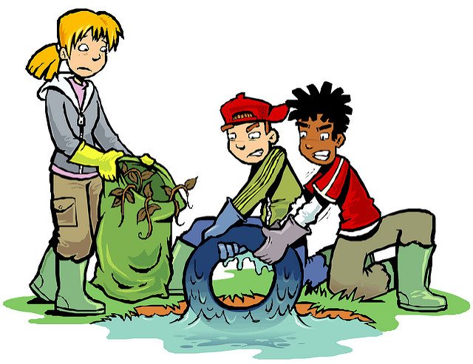
I am someone who…
Does my share to make my school and community better.
Cooperates
Is a good neighbor , student, son/daughter
Obeys laws and rules & respect adults
Protects the environment
Helps others (volunteering)

Slide 7
I am someone who…
Tells the TRUTH (honesty)
Makes good choices
Is loyal — stands by my family, friends, and country
Does what I say I will do
Does not cheat, lie, or steal

