Slide 1
Success
Overcoming Obstacles

Slide 2
The Story of Joe #1
Joe’s biggest interest was basketball. He enjoyed playing with his friends and watched games whenever he could. Joe tried out for the high school team once he was eligible, but he was not good enough to make the team his first year. Joe locked himself in his room and cried. He did not give up, he practiced all the time and played basketball as much as he could. During the time that he played basketball Joe recalls that he has missed over 9,000 shots, lost over 300 games, and failed to make the winning basket on 26 occasions. Joe says that his failures were important life lessons.

Slide 3
What was Joe’s goal?
What obstacles did he need to overcome to reach his goal?
What do you think happened to Joe? Did he reach his goal?

Slide 4
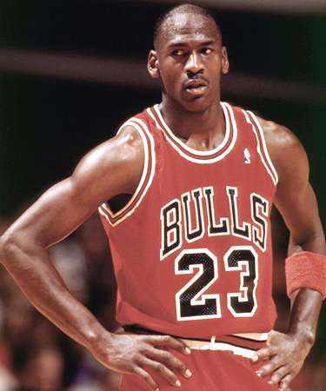
Joe is really Michael Jordan
“I have failed over and over and over again in my life. And that is why I succeed.“
Went on to play for UNC and was drafted into the NBA
5 MVP awards
14 NBA All-Star Game appearances and 3 All-Star Game MVP awards
6 NBA Finals MVP awards, and the 1988 NBA Defensive Player of the Year Award.
He holds the NBA records for highest career regular season scoring average (30.12 points per game) and highest career playoff scoring average (33.45 points per game).
In 1999, he was named the greatest North American athlete of the 20th century by ESPN, and was second to Babe Ruth on the Associated Press's list of athletes of the century.
He was inducted into the Basketball Hall of Fame in 2009.

Slide 5
The Story of Tim #2
When Tim was 7 years old, he moved to a new school. His teacher considered him to be hyperactive and stupid because he was too curious, asked too many questions, and was a slow learner. He was terrible at math, unable to focus, and had difficulty with words and speech. After 3 months of class his mother decided to home school him because she did not like the way Tim’s teacher was treating him. Tim spent most of his time reading science books that he got from his mother. He loved science and taught himself much of what he knows.

Slide 6
What do think Tim’s goal might have been?
What obstacles did Tim have to overcome in his life?
What do you think happened to Tim? Did he reach his goal?

Slide 7
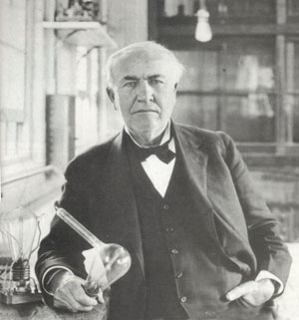
Tim is really Thomas Edison
Became one of the most important inventors of his time.
Invented the:
Phonograph
Incandescent light bulb
Camera to make motion pictures
Steel alkaline battery
Fruit preserver
Electric locomotive

Slide 8
The Story of John #3
John’s first love in life was writing. He worked hard in school and was accepted to Dartmouth College, where he became editor-in-chief of a magazine that the college published. He made some poor choices and was no longer able to write for the magazine. John’s father pushed him to be a college professor, while John just wanted to be a writer. He attended Oxford University to become a professor, but he decided that he did not want to stay on that career path. He landed a job as a cartoonist, but soon, that too was not enough. He decided to begin writing children’s books. John’s first book, To Think That I Saw It on Mulberry Street, was rejected by 27 different publishers.

Slide 9
What do think John’s goal might have been?
What obstacles did John have to overcome in his life?
What do you think happened to John? Did he reach his goal?

Slide 10
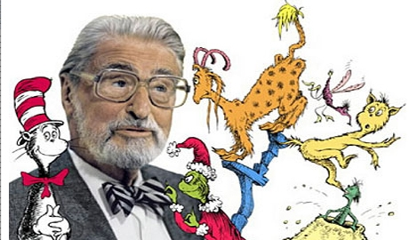
John is really DR. SEUSS!
Wrote AND illustrated 46 children’s books that have been translated into over 15 languages.
Sold over 200 million copies of his books.
Won two Emmy awards, two Academy awards, a Peabody award, and a Pulitzer prize.

Slide 11
The Story of Sam #4
Sam always wanted to make movies. When he was in high school he created amateur adventure films with his friends for fun. After finishing high school he applied to the University of Southern California School of Theater, Film and Television. He applied three times and was rejected each time. Sam eventually attended school at another location, only to drop out to become a director before finishing. During college, Sam took an internship with Universal Studios as an editor of films. He worked seven days a week and was not paid for his help.

Slide 12
What do think Sam’s goal might have been?
What obstacles did Sam have to overcome in his life?
What do you think happened to Sam? Did he reach his goal?

Slide 13
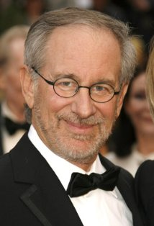
Sam is really Steven Spielberg
Became one of the most influential directors in Hollywood
He also produced and wrote many movies that he directed.
Directed movies like:
Jaws
E.T. Extra-terrestrial
Indiana Jones
Jurassic Park
Transformers
Saving Private Ryan
Adventures of TinTin
Hook
Casper
Twister
Men in Black

Slide 14
The Story of Ella #5
Ella was almost two when she got an illness that left her deaf and blind. Ella had to develop her own signs to communicate with her parents, which was often frustrating for both of them. One day, Anne Sullivan, a specialist who worked with people who have hearing and visual impairments, came to live with Ella to teach her formal sign language. Ella did not learn quickly and became very frustrated when she could not understand the sign for something. Anne stayed and kept working with Ella. Once Ella began to understand how to sign, she wanted to know more and asked Anne to teach her as much as she could. Ella went on to learn more about sign language at schools for the deaf and the blind. She worked hard through middle and high school and eventually went on to Radcliffe College.

Slide 15
What do think Ella’s goal might have been?
What obstacles did Ella have to overcome in her life?
What do you think happened to Ella? Did she reach her goal?

Slide 16
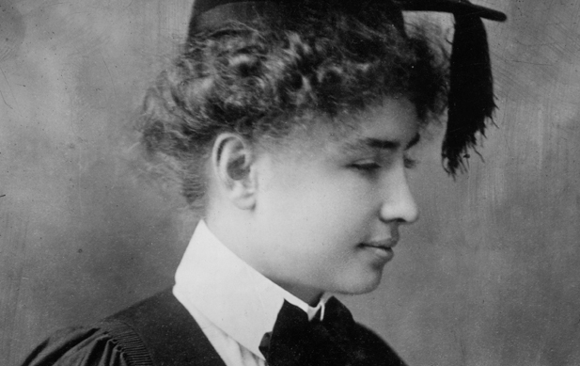
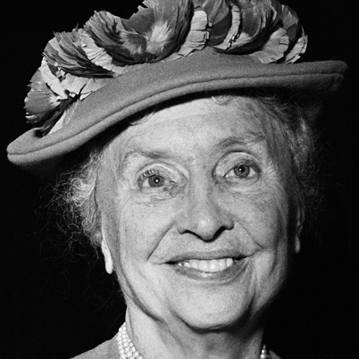
Ella is really Helen Keller
She graduated from college magna cum laude!
She wrote numerous articles, books, and met with U.S. presidents to promote prevention of blindness, and to help spread awareness.
She won numerous honors, including honorary university degrees, the Lions Humanitarian Award, the Presidential Medal of Freedom, and election to the Women's Hall of Fame.

Slide 17
Now… it’s your turn
1. What obstacles do you face? 2. Will you still climb the ladder and overcome them? 3. What do you dream of becoming? 4. What will you do to get there?

