Slide 1
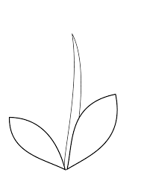
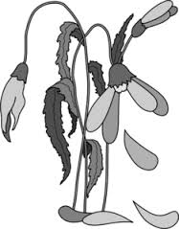
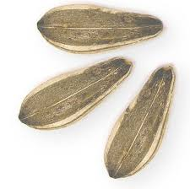
Name:__________________ Domain 4 Assessment
Life Cycle of a Plant
1 | 2 | 3 | 4

