Slide 1
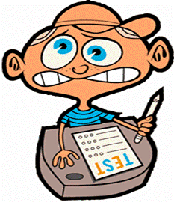
Test taking strategies

Slide 2
ATTITUDE
Go in with a positive attitude (think positive thoughts instead of negative thoughts).
Remember one test will not make/break you.
Don’t assume the worst.
Use positive self-talk instead (be your own best cheerleader).
You will get through this test, take deep breaths, and try your hardest!

Slide 3
BEING PREPARED:
• Develop good study habits
• Plan to study in advance- don’t cram (study a little each night).
• Learn about the test (if you can)
• Know what types of questions are on the test.
• Know what information you will need to know to study for the test.
• Get a good night’s sleep
• Fuel your body

Slide 5
BEING MENTALLY PREPARED:
Build your confidence with positive self-talk
Relaxation techniques:
- The Bodybuilder (tensing muscles and then releasing them by muscle group)
- The Superstretch (stretching all of your muscles by reaching into the sky)
- The Playful Wind (deep breath in to pull the boats toward shore, deep breath out to push them out to sea).
- Breathing in “4” (Breathe in to the count of four, hold it to the count of four, breathe out to the count of 4).
- The Palming Method (palms over your eyes and imagine your peaceful place- breathe deeply).

Slide 6
TEST TAKING TIPS/TRICKS:
• Answer the easiest questions first
• If you do not know an answer, skip the question and come back to it. You might find some helpful hints in other parts of the test.
• Always read the whole question and all of the answers first before choosing one.
• Never rush (the test is not a race)!
• Circle key words in difficult questions.
• If you are having trouble on a multiple choice question, eliminate answers that you KNOW are wrong first and then go back and see what is left.
• Double check your work. Silly mistakes happen when we are anxious and rushing.

