Slide 1
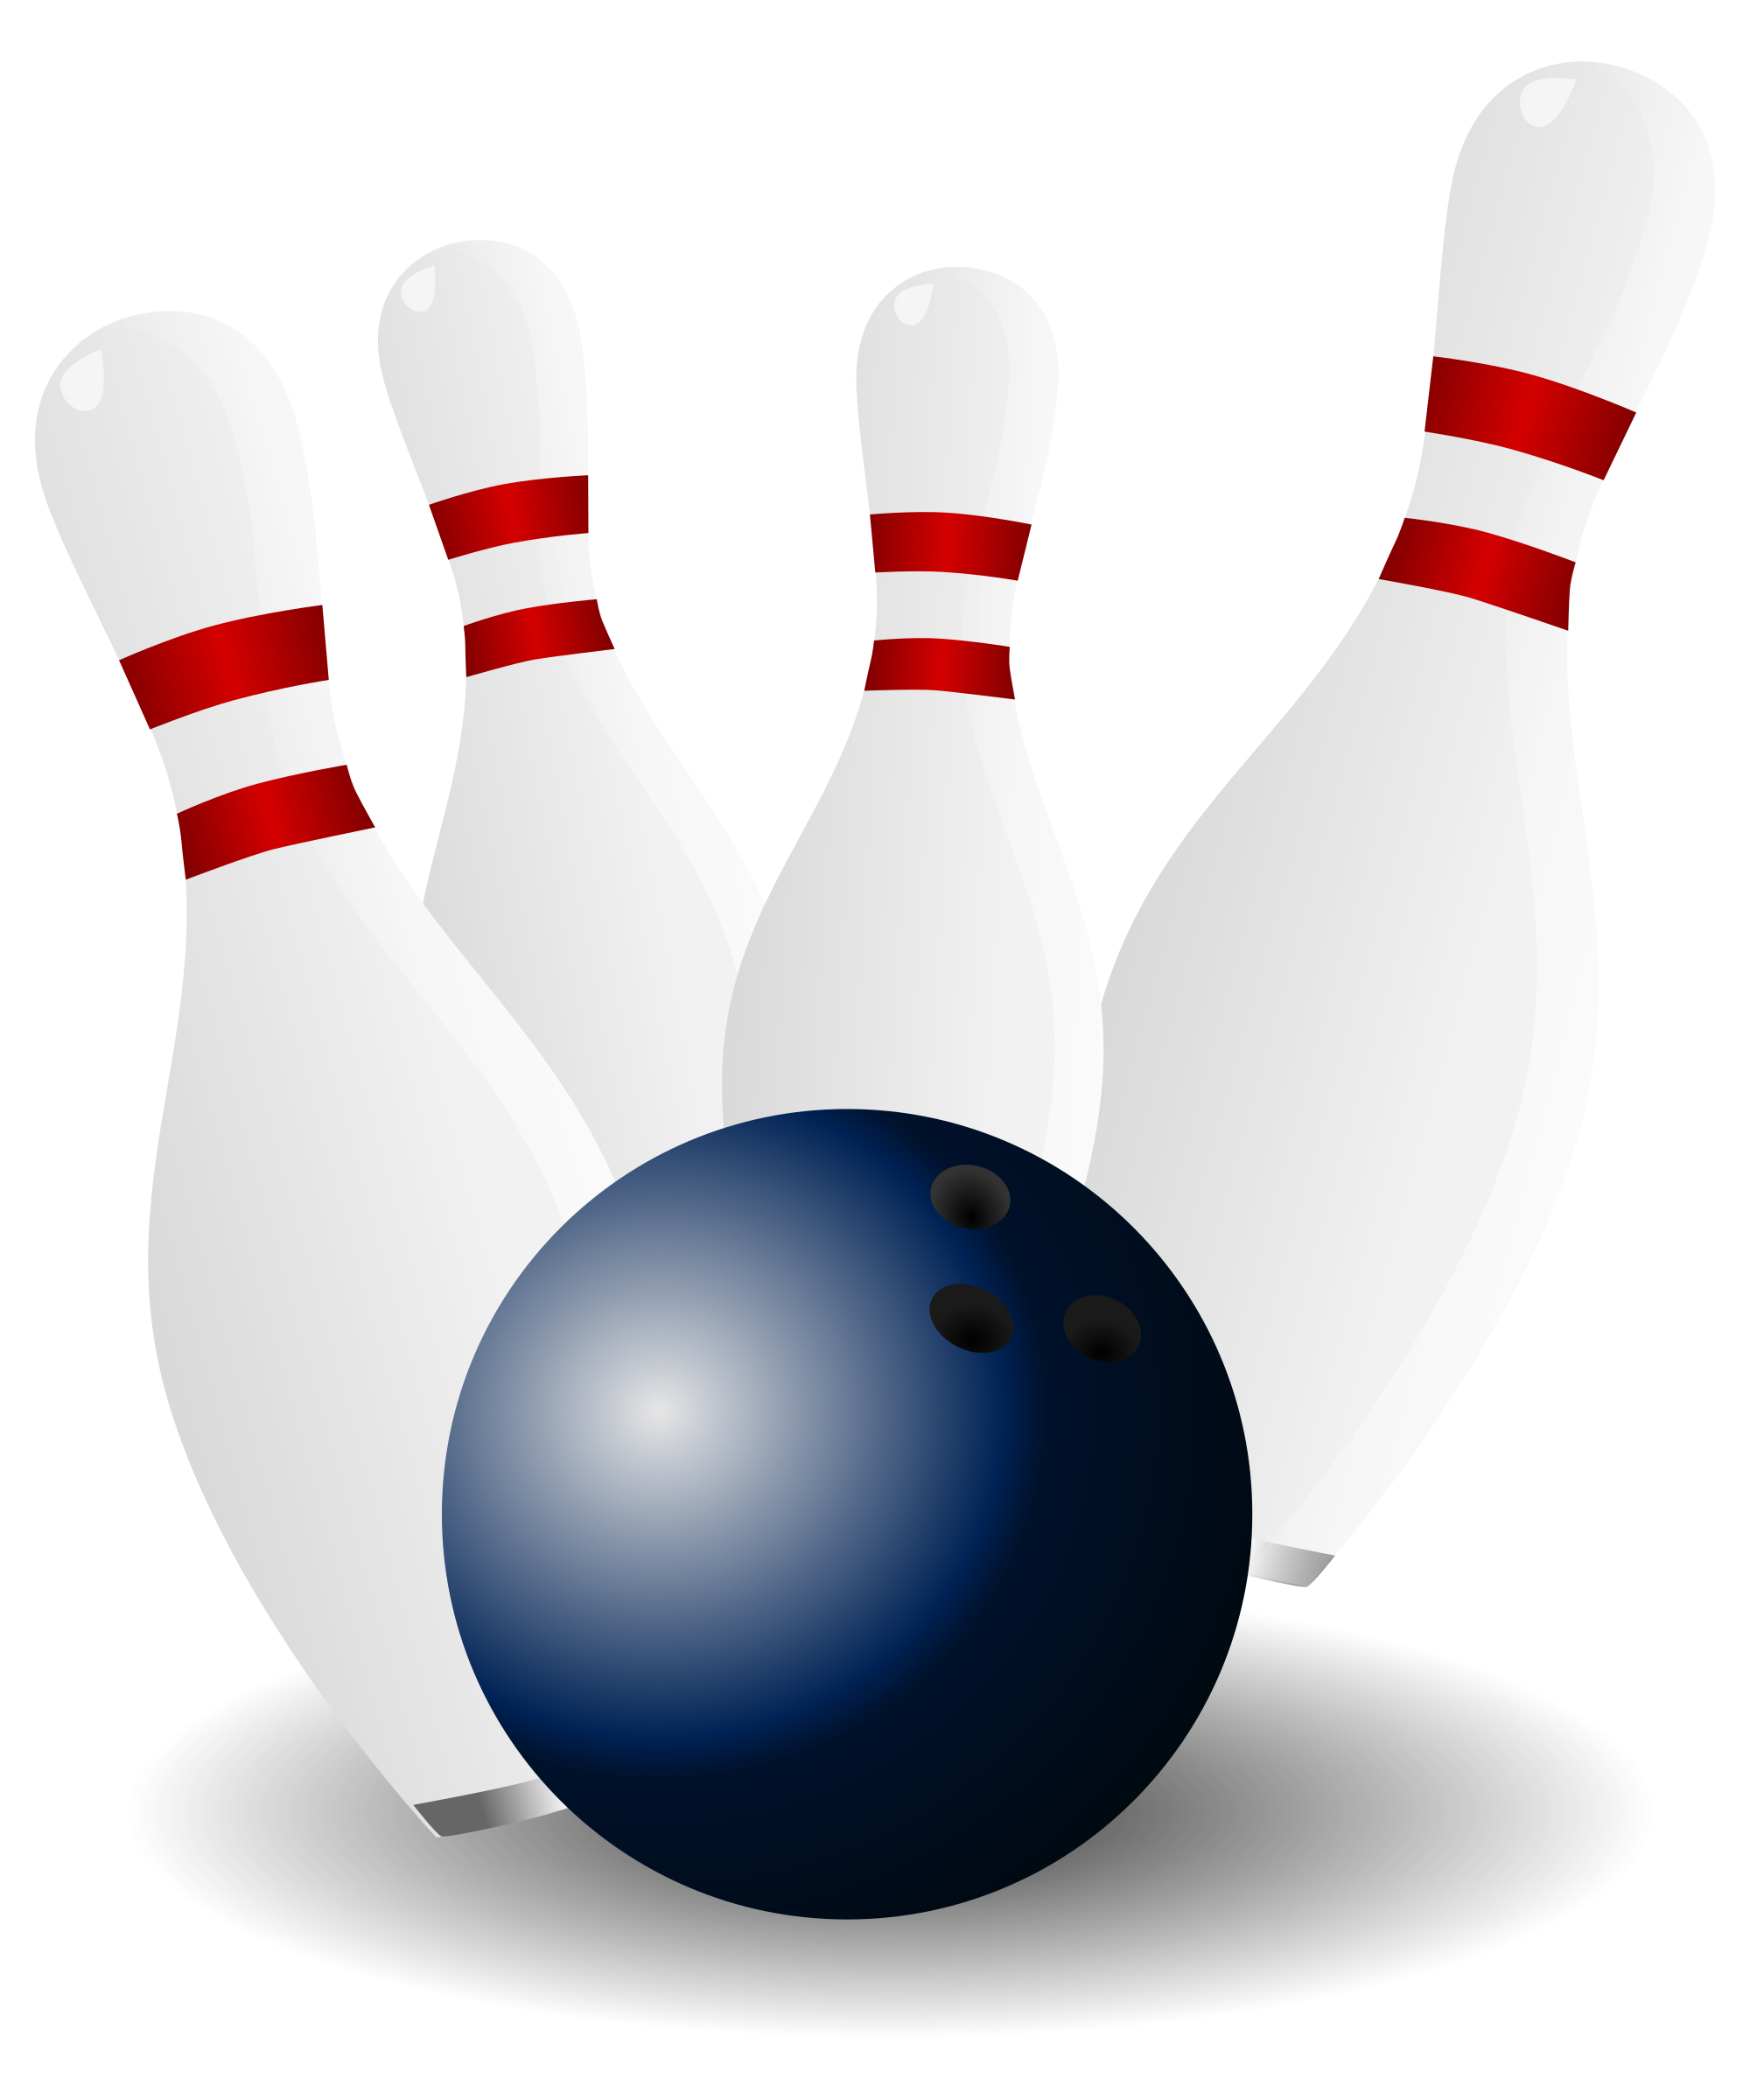
Name That Character Trait Bowling
2nd Grade

Slide 2
RULES:
The class will be divided into 2 teams.
Each team will have one ball and one set of pins.
Within each team, students will pair up and decide which person in the pair will be the bowler, and which person will set up the pins and retrieve the ball at the end of his/her partner’s turn.
Bowlers from each team will be competing against one another at the same time.
The bowling pair that knocks down the most pins earns the opportunity to “Name That Character Trait,” and will be able to earn points for their team if they correctly identify the character trait being demonstrated in the story.
The amount of points a team earns is equal to the amount of pins that they knock over.
Teams who can identify more than one character trait for the story can earn bonus points.
If an incorrect answer is given, the opposing team can “steal” the story and earn points for their team if they correctly identify the character trait(s). (They can only earn points equal to the amount of pins they knocked over).

Slide 3
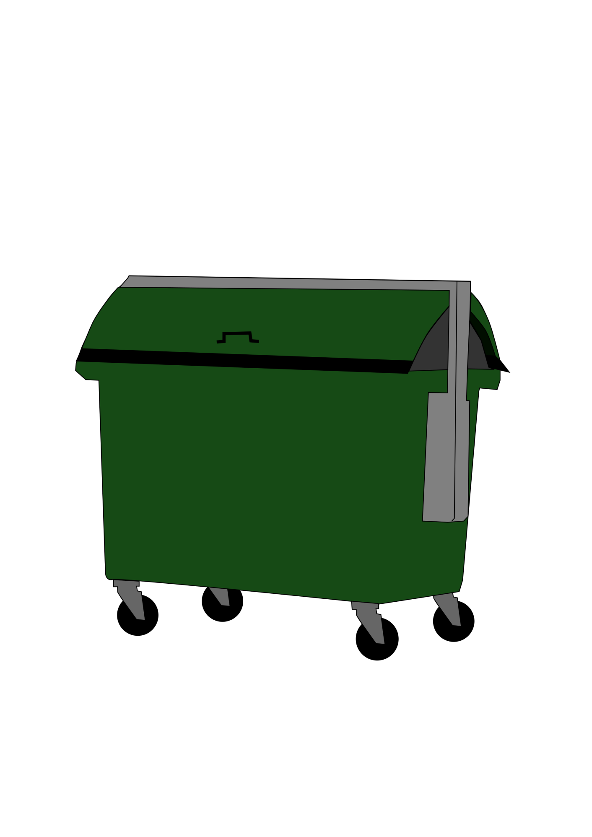
Tasha picked up the garbage on the playground and put it in the garbage can, even though the garbage wasn’t hers.”

Slide 4
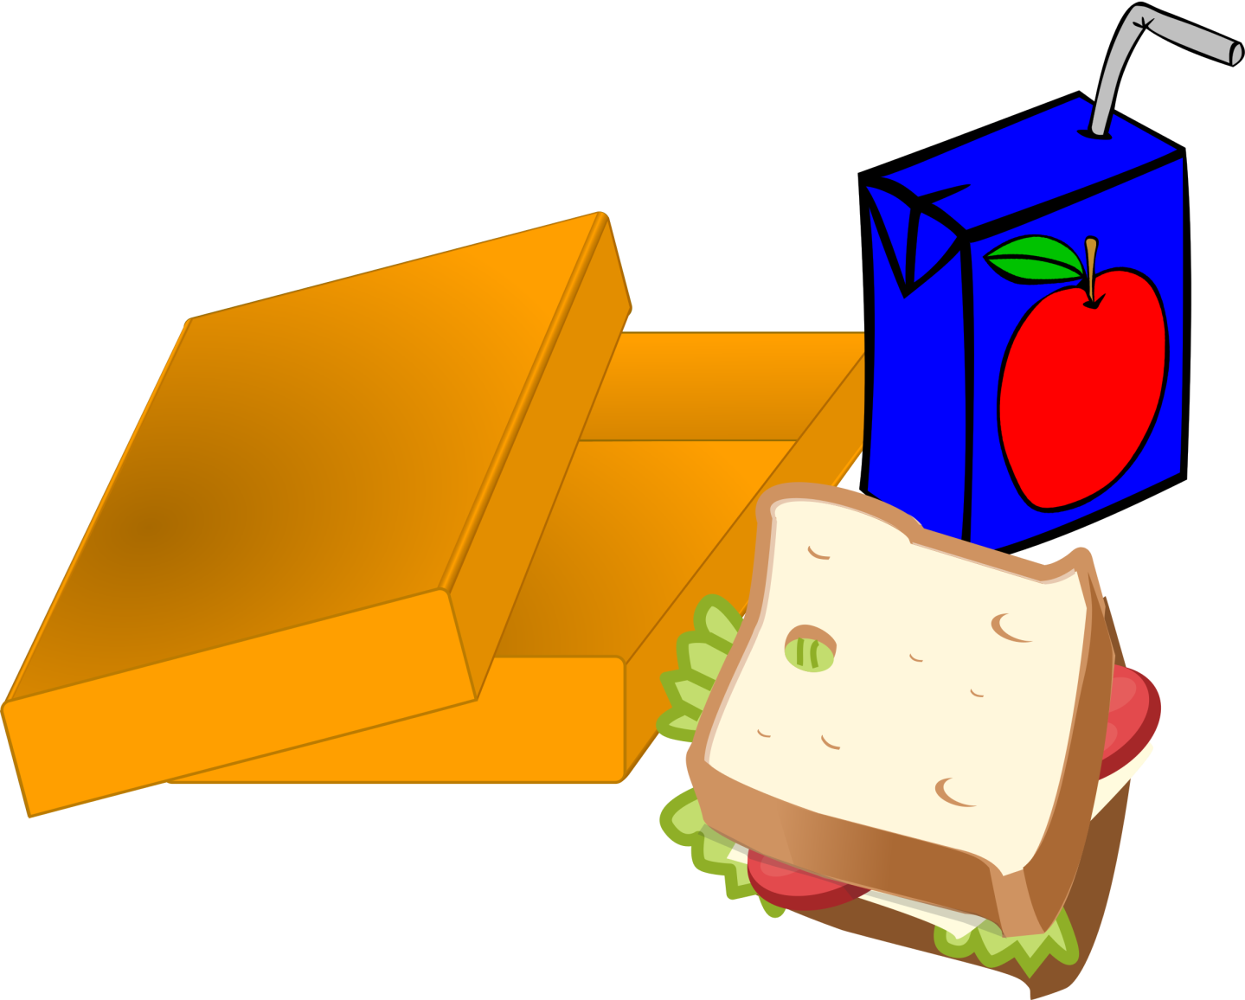
Alex noticed that Ella was sitting by herself at lunch every day, so he decided to ask her if she wanted to sit with him and his friends.”

Slide 5
Jaxon worked hard to practice his saxophone so that he would be prepared for Ms. Chamberlain’s music lessons. “

Slide 6
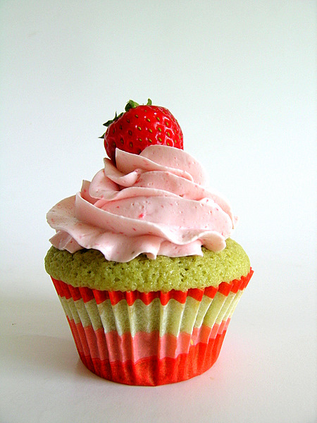
Taylor brought cupcakes for the class for her birthday, and she made sure to have enough so that every student would get one.”

Slide 7
Zach did not do his homework because he spent too much time riding his bike and ran out of time before bed. When he got to school, he told his teacher that he was sorry because he did not complete his homework and that he would get it done during recess.

Slide 8
“While Maddie is raking her lawn, she notices that her neighbor hasn’t done his yet. She brings her rake over to his yard and starts raking his leaves too.”

Slide 9
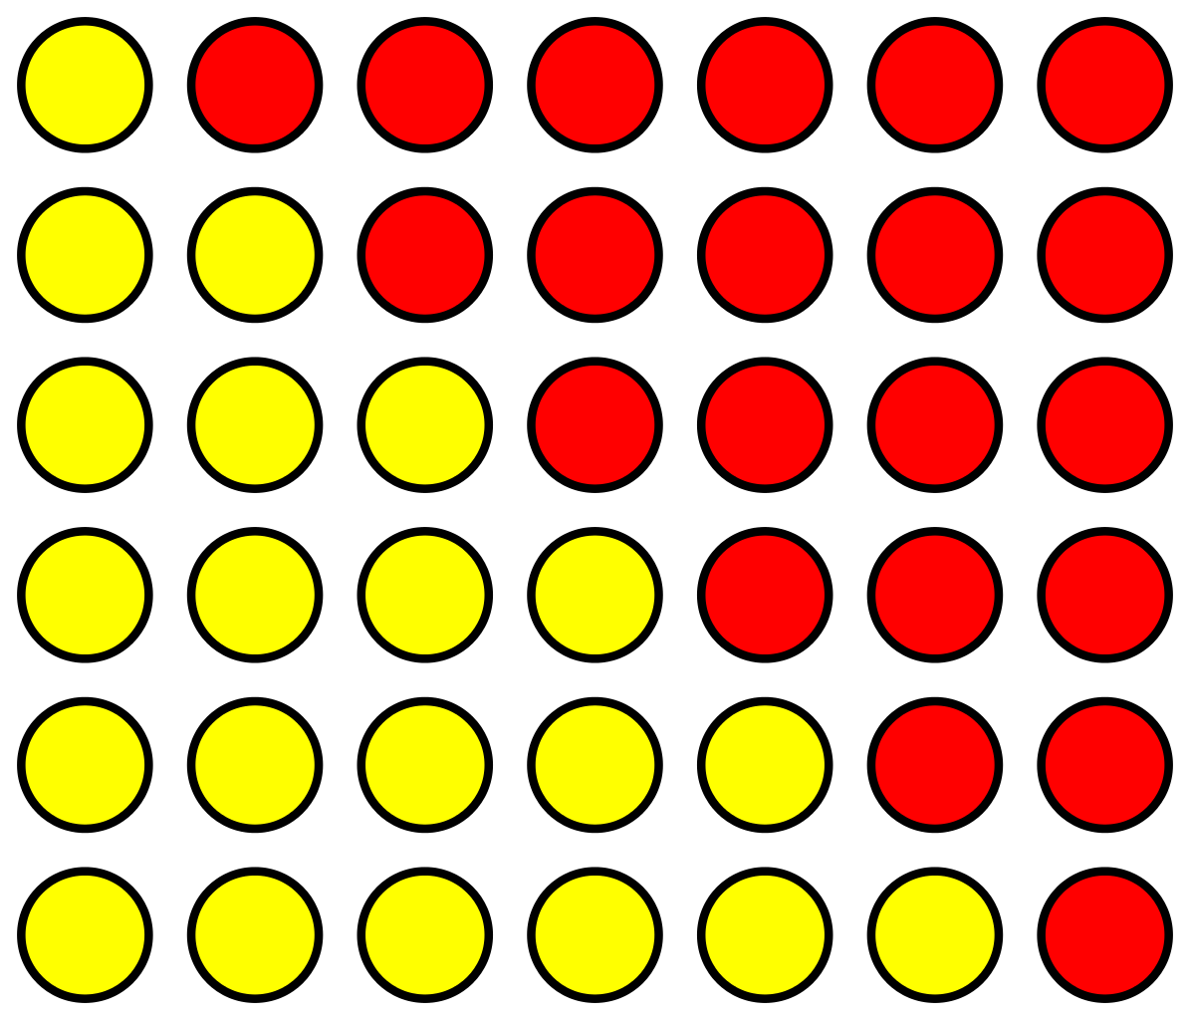
Hannah cheats during Connect 4 at recess and instead of tattling on her for cheating, Thomas asks her nicely if she could follow the rules of the game so that everyone has an equal chance to win.”

Slide 10
Sarah and Jamal are taking permission forms back to the office, and they walk quietly in the hallways.”

Slide 11
Tucker broke his leg, so Katie volunteers to help carry his book bag and lunch pail when he gets off the bus each morning so that he can use his crutches.”

Slide 12
Both Charlie and Blake want to use the last soccer ball at recess, so Blake decides to ask Charlie to join his team so that they can all play soccer together.”

Slide 13
Every night when Kara gets home from school, she gets her homework done at the kitchen table. She gets her homework back in her folder, puts it back in her bag, and puts the bag by the door so she wont forget it. She she goes out to play after her work is done.”

Slide 14
Tyler helps collect cans as a charity fundraiser for his Boy Scouts group. All the money they collect when they return them will go to the Children’s Hospital .”

Slide 15
Ericka creates a Minecraft group at school. One of her friends suggested only people that own the game could join. Ericka tells her friend that everyone should be able to join the group, even if they are not able to own the game.

Slide 16
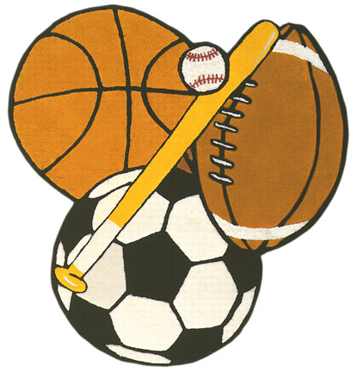
Oliver always works hard in school, follows the rules and directions, and is nice to his classmates. Oliver gets to help Mr. Smykla pick up the P.E. equipment at the end of each day.”

Slide 17
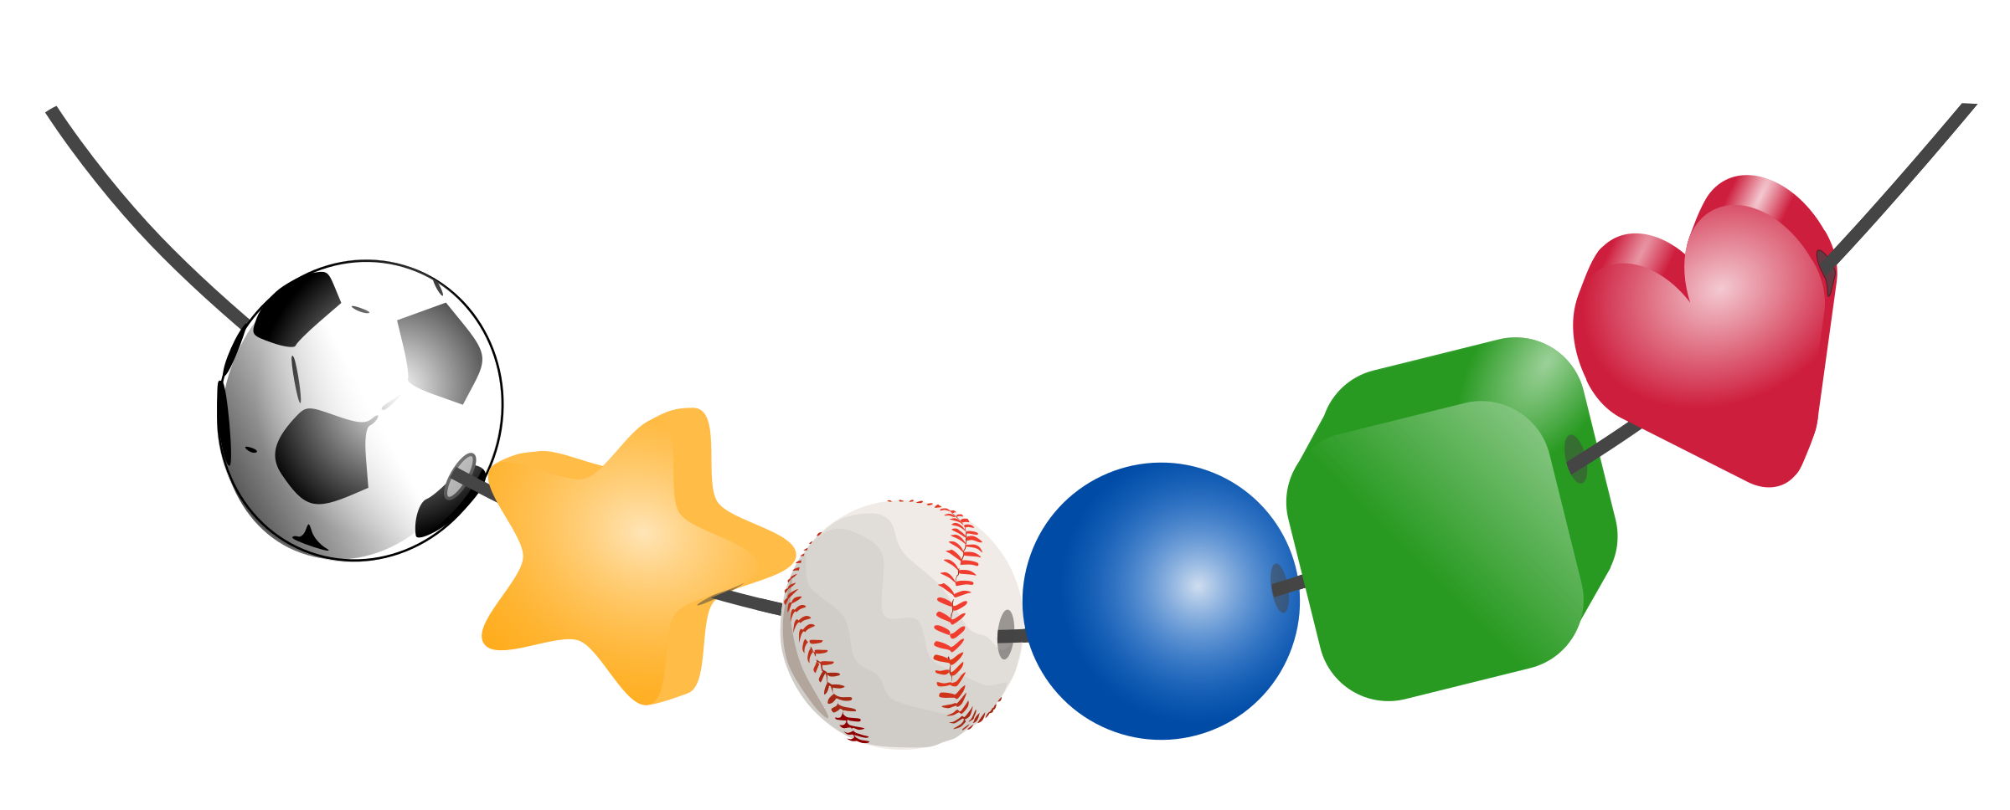
Lennox spent the whole morning creating a necklace from her bead collection to give to her sister as a birthday gift.”

Slide 18
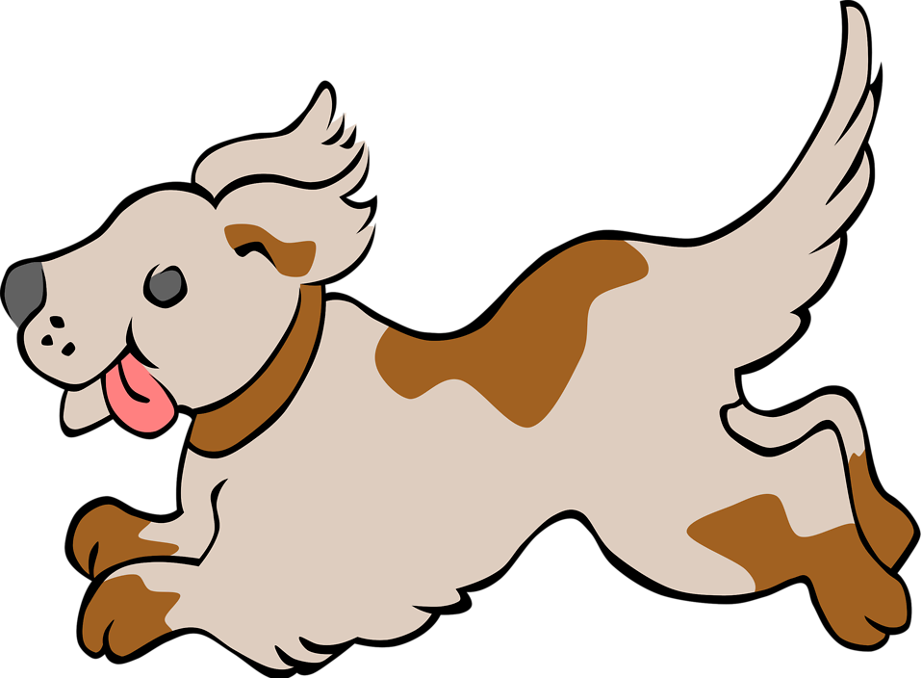
Every morning Owen takes his dog for a walk, gives him food and water, and then gets himself ready for school.”

Slide 19
Max and Lettie take turns using the Ipad so that they can each play a math game during centers.”

Slide 20
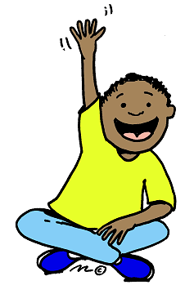
Austin always raises his hand when he wants to ask a question, he sits criss cross applesauce on the carpet, and he waits to be called on before he gives an answer.”

Slide 21
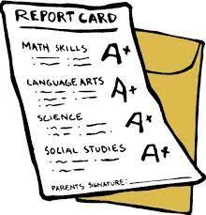
Stella tries her best everyday and completes her class work as well as her homework. Stella has set a goal to have a good second grade report card, and she never stops trying to make it happen.”

Slide 22
Joy knew that Mrs. Gerow was out sick for the day, so he used his free time to make her a get well card.”

