Slide 1
The Long Decline of the Western Roman Empire
5
How did Roman emperors try to end the crisis in the empire?
How did Hun invasions contribute to the decline of Rome?
How did economic and social problems lead to the fall of Rome?

Slide 2
The Empire in Crisis
5
With the end of the Pax Romana, political and economic turmoil rocked the Roman empire.
Political Problems
Economic & Social Problems
Emperors were repeatedly overthrown or assassinated.
In one 50-year period, 26 emperors ruled, and only one died of natural causes.
High taxes to support the army burdened business people and farmers.
Poor farmers were forced to work and live on wealthy estates.
Overcultivated farmland lost its productivity.

Slide 3
Decline and Fall
Rome wasn’t built in a day and it took a long time to decline. Eventually the emperor Diocletian divided the empire into eastern and western empires.
Western empire fell into chaos and was invaded
Eastern empire survived as a center of trade and culture and became the Byzantine Empire.

Slide 4
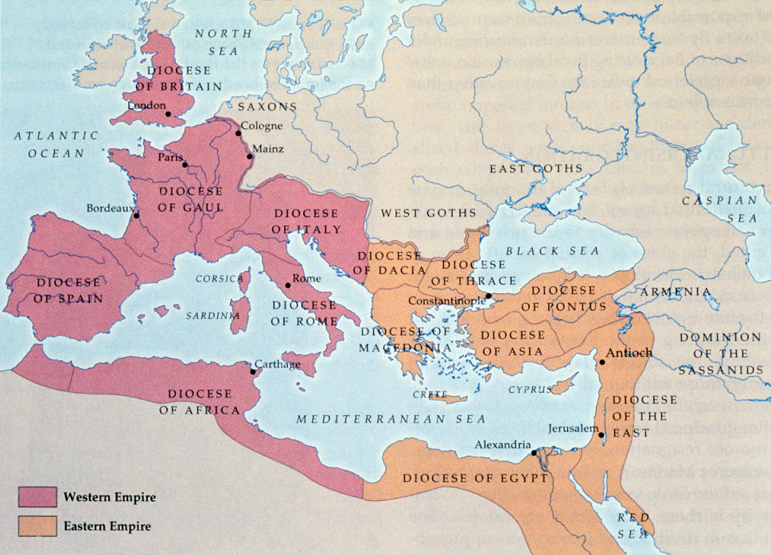

Slide 5
Two Reformers
5
Diocletian
Constantine
Divided the empire into two parts to make it easier to govern
Tried to increase the prestige of the emperor
Fixed prices to slow inflation, or the rapid rise of prices
Established laws to ensure steady production of food and goods
Continued Diocletian’s reforms
Granted toleration to Christians, which led to the rapid growth of Christianity
Built a new capital at Constantinople, making the eastern part of the empire the center of power

Slide 6
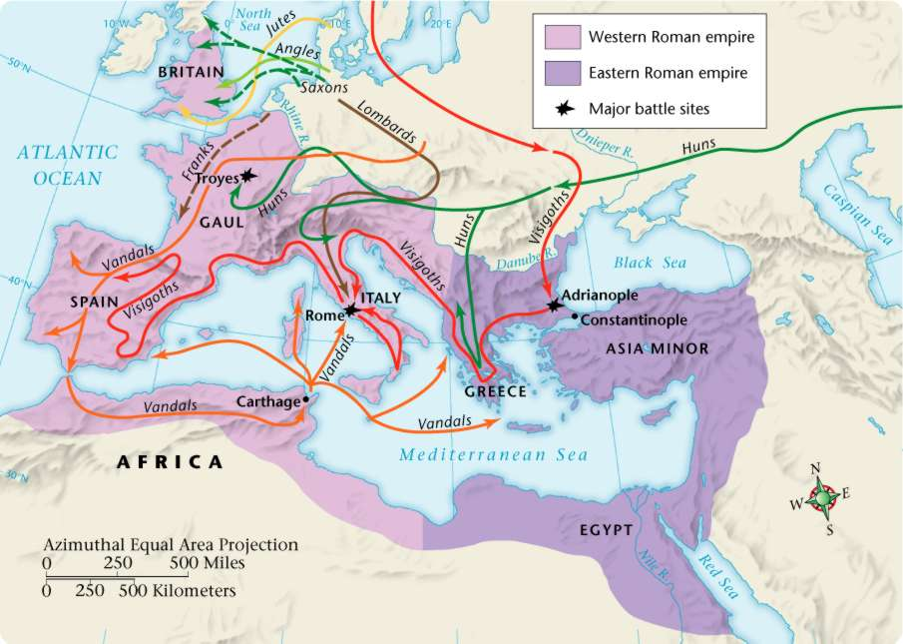
Foreign Invasions
5
A weakened Rome could not withstand the forces of Germanic invasions.
The Huns dislodged other Germanic peoples and, little by little, conquered the Roman empire.

Slide 8
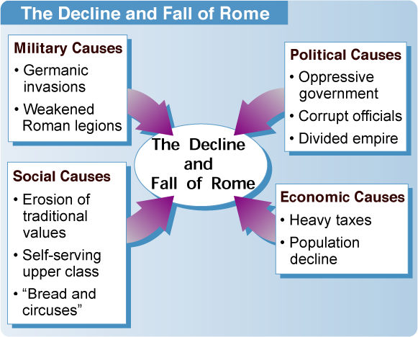
The Decline and Fall of Rome
5

Slide 9
Review Questions
5
Why did Diocletian divide the empire into two parts?
to separate the Jews from the Christians
to make it easier to govern
to defend against the Huns
to allow the two halves to compete with each other
One political cause of the decline of the empire was that a) the government was oppressive. b) traditional values eroded. c) the population declined. d) farmers were taxed too heavily.

Slide 10
Fall of Western Roman Empire Assessment
5
Why did Diocletian divide the empire into two parts?
to separate the Jews from the Christians
to make it easier to govern
to defend against the Huns
to allow the two halves to compete with each other
One political cause of the decline of the empire was that a) the government was oppressive. b) traditional values eroded. c) the population declined. d) farmers were taxed too heavily.

